Slide 1
Developing 21st Century Communication Skills

Slide 2
CEFR
‘Communicative language competence can be regarded as comprising several components:
linguistic, sociolinguistic and pragmatic’.

Slide 3
Encoding
Channel
Decoding
Receiver
Feedback
Source
Message
The Elements of Communication: A Theoretical Approach, Will Gemma December 13, 2013. Following Claude Shannon, Wilbur Lang Schramm and Robert Craig. https://blog.udemy.com/elements-of-communication/

Slide 4
Source
Who is sharing the information?
Why do they want to communicate?
Must have channels open to them.
Notes:
‘Who’ is not a fixed thing. Who I am is a product of the relationship I am in with the other(s).
1. Source
The source is the person (or thing) attempting to share information. The source can be a living or non-living entity. The only qualifications necessary for a source are an origin of information (in Information Theory, the source generates data that one would like to communicate) and an ability to transmit this information, through a channel, to a receiver.

Slide 5
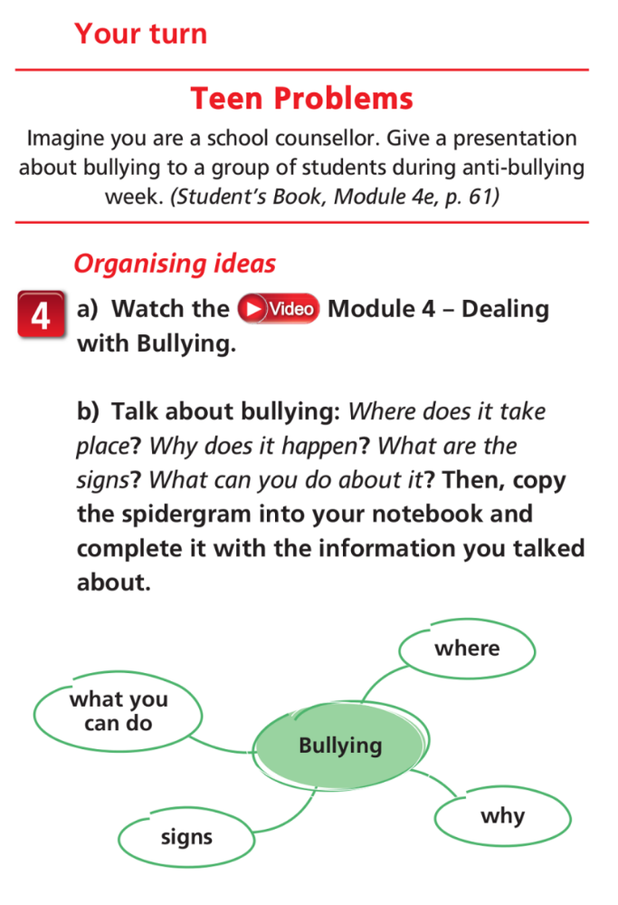

Slide 6
Message
The information I want to communicate.
Message and format must be congruent.
Notes:
2. Message
At first glance, the message is simply the information you want to communicate. But it goes deeper than that. Communication theorists examine messages from a semiotic perspective (the study of signs and symbols, and how meaning is created through them; note: it is not the study of meaning, just how meaning is created). For example, a commencement speaker produces meaning through several criteria. First, there is the object (in this case, the speaker has an inherent meaning, maybe through being a local celebrity or famous alum). The second criterion would be his or her image, acting as a symbol or representation of the meaning of the object (a well-dressed, professional and successful person). The third criterion is interpretation or derived meaning. If the object and image (and, in this case, speech) are successful, then the audience will leave with an understanding of how to proceed toward a life of personal fulfilment.

Slide 7
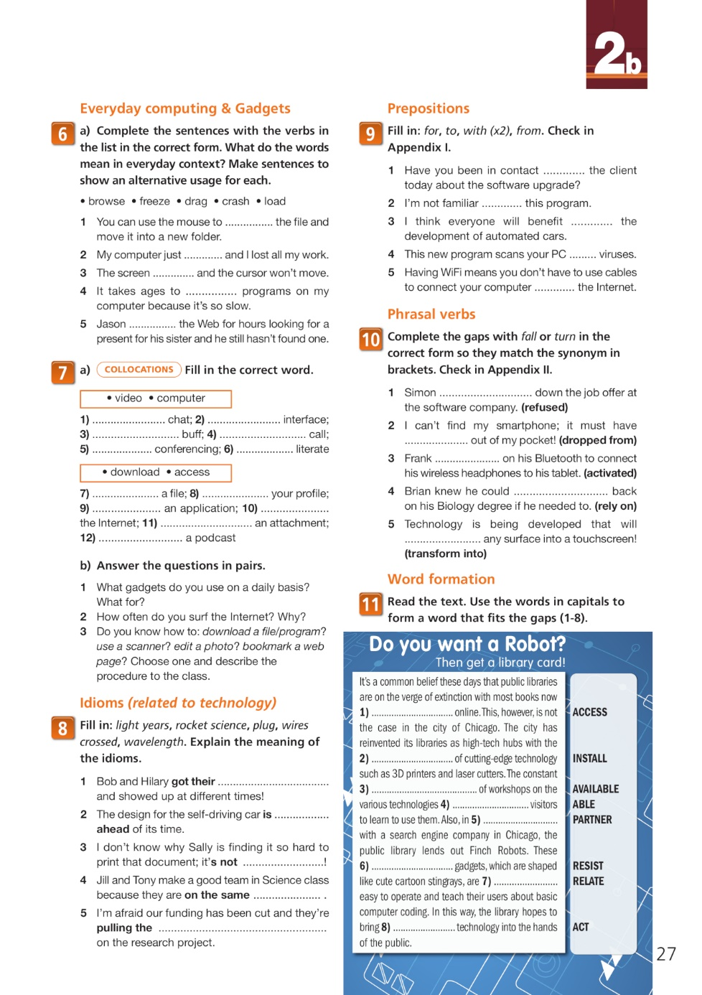

Slide 8
Encoding
Preparing a message in a way the receiver can understand.
Awareness of what could prevent clear communication.
Notes:
3. Encoding
Encoding is the process of assembling the message (information, ideas and thoughts) into a representative design with the objective of ensuring that the receiver can comprehend it. Communication is only established when it results in both the source and the receiver understanding the same information. People who are great communicators are great encoders; they know how to present their message in a way that their audience (receivers) can easily understand. They are also able to identify information that is superfluous, irrelevant or even accidentally offensive, and eliminate it in advance through anticipation.

Slide 10
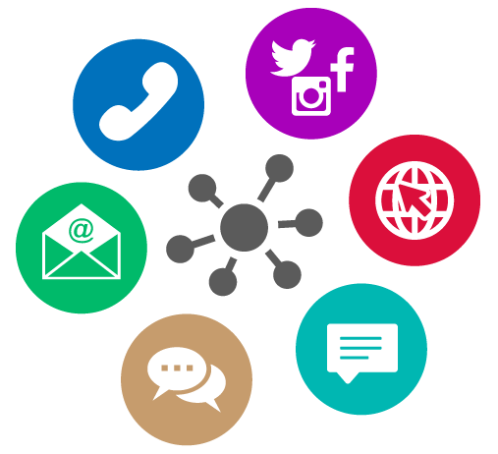
Channel
Wide choice of channels
Which is the right choice for the message?
Notes:
How are online conversations different?
4. Channel
An encoded message is conveyed by the source through a channel. There are numerous channel categories: verbal, non-verbal, personal, non-personal, etc. A channel could be the paper on which words are written, or the Internet acting in the client-server model that is allowing you to read these words right now.
A good communicator is one who understands which channels to use under different circumstances. Unfortunately, there is no perfect channel. All channels have strengths and weaknesses (smartphones are great, for example, but a marriage proposal is best done in person).

Slide 11
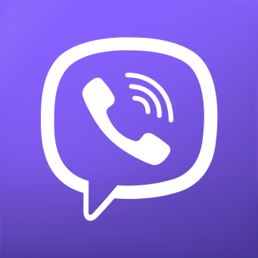
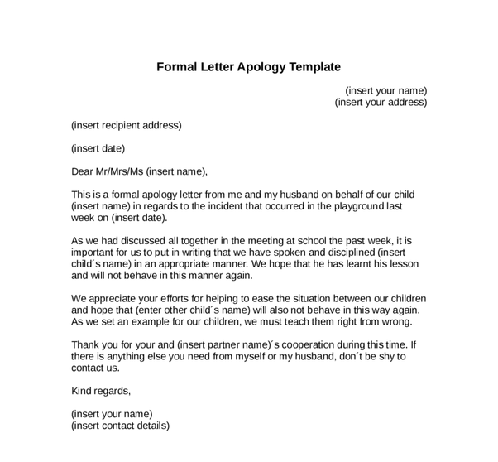
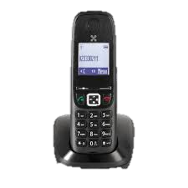
Notes:
Skype face to facev

Slide 12
Decoding
Unpacking the same message.
What do you do if you can’t?
Notes:
5. Decoding
Now would be an appropriate time to remind yourself that you can just as easily fill the role of decoder as you can encoder. This is where listening, and reading directions carefully, makes its claim to fame—decode with care, my friends. As we discussed in Encoding, communication is only successful when it results in both the source and the receiver understanding the same information. For this to happen, there can be no errors in processing. The most common among these would be, for example, a first-grader sitting in on a lecture on differential equations, i.e. decoding is impossible if the decoder cannot even understand the message.

Slide 13
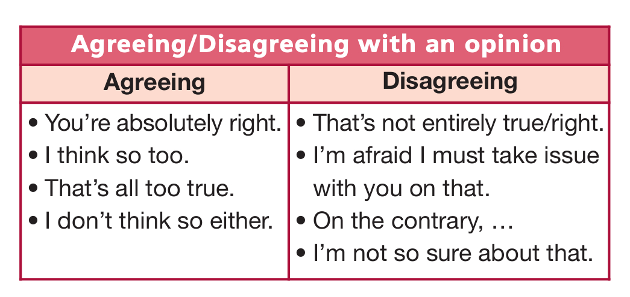

Slide 14
Receiver
Who is the information aimed at?
How might they react (decode)?
Notes:
6. Receiver
Ultimately, the message is delivered to the receiver. A good communicator takes the receivers preconceptions and frames of reference into consideration; how they will react, where common ground is shared, their sense of humour, their moral conduct, etc. All of these things will affect how the receivers decode messages.

Slide 15
How would you address…
A colleague?
A close friend?
A child?
A parent?
A conference?
A tax official?

Slide 16
Feedback
What reaction do I get?
What does that tell me?
Notes:
7. Feedback
A better word might be “reaction” or “responses.” The source judges its success based on the feedback it receives, so pay close attention. If Google’s servers crashed tomorrow, there would be a lot of confused sources. The same would be true if you delivered a flawless marriage proposal, only to receive a look of bewilderment and horror. And then there are famous marketing nightmares, such as Aqua Teen Hunter Force’s LED signs that were mistakenly identified as explosive devices. Feedback is the moment of reckoning. Whether things go right or wrong, it serves as one of the most important learning opportunities we have.

